Slide 1

Firewall / UTM

Slide 2
Topics To Cover
Establishing Rules and Restrictions for Firewall
Firewall Configuration Strategies
Scalability
Firewall Architecture
Protection against hacking
Multi-layer firewall protection
Firewall deployment strategies
Advantages of using Firewalls
Threats
Limitations of Firewalls

Slide 3
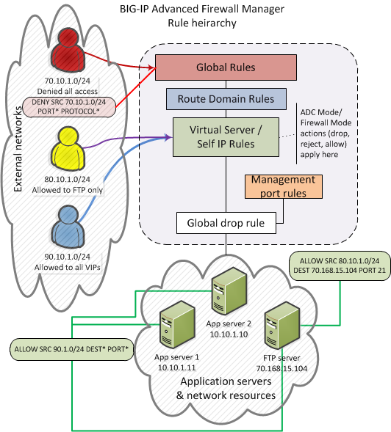
Establishing Rules and Restrictions for Firewall

Slide 4
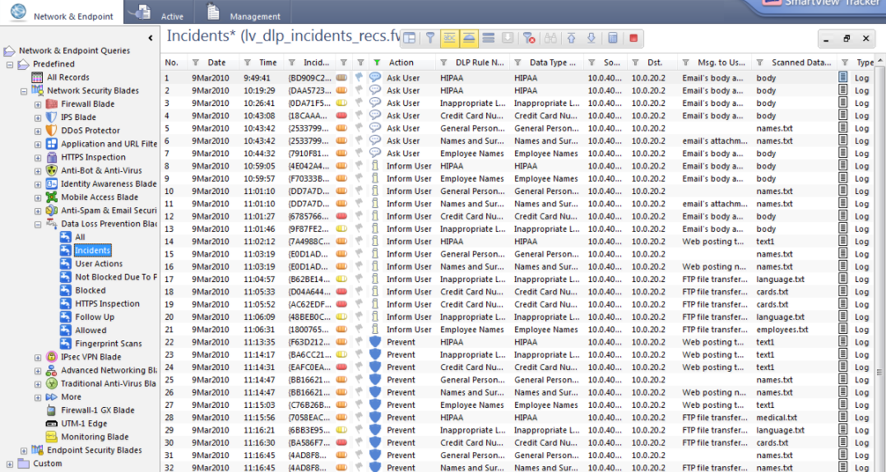

Slide 5
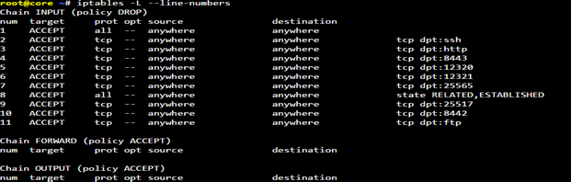

Slide 6
Rule or Rule List:
Specifies whether the configuration applies to this specific rule, or to a group of rules.
Source Address:
One or more addresses or address lists behind the firewall to which the rule applies.
Source Port:
The ports or lists of ports on the system behind the firewall to which the rule applies.
VLAN:
Specifies VLANs behind the firewall to which the rule applies.

Slide 7
Destination Address:
One or more addresses or address lists outside of the firewall to which the rule applies.
Destination Port:
The ports or lists of ports outside of the firewall to which the rule applies.
Protocol:
The protocol (TCP, UDP, ICMP, ICMPv6, or Any) to which the rule applies. Select one specific protocol, but not two protocols.
Schedule:
Specify a schedule for the firewall rule. Configure schedules to define days and times when the firewall rule is made active.

Slide 8
Action:
Specifies the action (accept, accept decisively, drop, or reject) for the firewall rule.
Logging:
Specifies whether logging is enabled or disabled for the firewall rule.
Packet filtering or packet purity:
Data flow consists of packets of information and firewalls analyze these packets to sniff out offensive or unwanted packets depending on what you have defined as unwanted packets.
Inspection:
In this case Firewalls instead of sifting through all of the information in the packets, mark key features in all outgoing requests & check for the same matching characteristics in the inflow to decide if it relevant information that is coming through.

Slide 9
Domain names:
Allow certain specific domain names to access systems/servers or allow access to only some specified types of domain names or domain name extension like .edu or .mil.
Protocols:
A firewall can decide which of the systems can allow or have access to common protocols like IP, SMTP, FTP, UDP, ICMP, Telnet or SNMP.
Ports:
Blocking or disabling ports of servers that are connected to the internet will help maintain what kind of data flow to see it used for & also close down possible entry points for hackers or malignant software.
Keywords:
Firewalls also can sift through the data flow for a match of the keywords or phrases to block out offensive or unwanted data from flowing in.

Slide 10
Traffic Shaping:
Traffic Shaping policies is to manage and distribute total bandwidth according to parameters such as user, firewall, web category, or application.
Accept:
Allows packets with the specified source, destination, and protocol to pass through the current firewall context.
Drop:
Drops packets with the specified source, destination, and protocol.
Reject:
Rejects packets with the specified source, destination, and protocol.
Rejecting a packet is a more graceful way to deny a packet, as it sends a destination unreachable message to the sender.

Slide 11
Firewall Configuration Strategies
Should inventory the applications on your workstations and servers that might establish listening endpoints, the ports that each application and OS use.
The UpnP protocol lets devices discover and dynamically configure each other in response to running applications and services. Universal Plug and Play.
Web server in a demilitarized zone (DMZ) will be required to accept only incoming connections on port 80/TCP (HTTP) or 443/TCP (HTTP Secure HTTPS).
One interface is connected to the Internet and others are connected to private networks.

Slide 12
Netstat command to determine which ports are open and which applications and services are listening on them.
Network Address Translation (NAT): NAT hides the internal addresses from the external network (Internet) or outside world.
Block by default: Block all traffic by default and explicitly allow only specific traffic to known services.
Allow specific traffic: The rules that use to define network access should be as specific as possible.
Source IP address (or range of IP addresses).
Destination IP address (or range of IP addresses).
Destination port (or range of ports).

Slide 13
Scalability
Scalability is the ability of a system, network, or process to handle a growing amount of work in a capable manner.
Throughput can be considered both in terms of bits per second and packets transferred per second.
Number of monitored devices.
Size of policies, ACLs and Routing tables.
Volume of traffic logs.
Number of applications and connectivity dependencies to be managed.
Support for multiple Internet Service Providers.

Slide 14
Firewall Architecture
Dual Homed Gateway Architecture
Screened Host Gateway Architecture
Screened Subnet Architecture
Screening Router Architecture

Slide 15
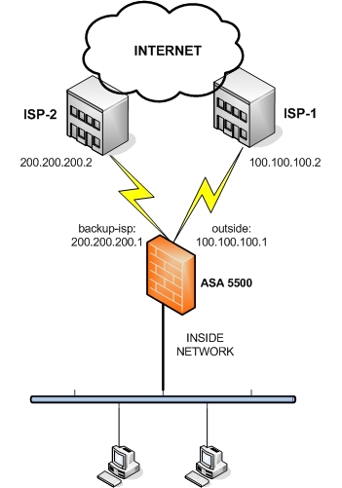
Dual Homed Gateway Architecture

Slide 16
Architecture with two networks (ISP’s) as a dual-homed gateway.
Deny all services unless they are specifically permitted.
High degree of privacy since routes to the protected subnet.
Routers connected directly to the firewall and not to Internet systems.
The firewall can also log access and log attempts or probes to the system that might indicate intruder activity.
The router can prevent direct Internet access to the firewall and force access to go through the firewall.

Slide 17
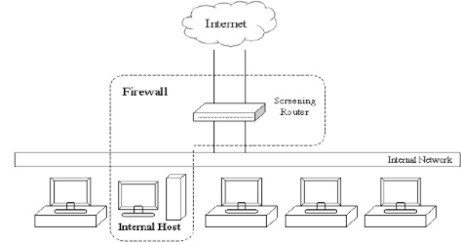
2. Screened Host Gateway Architecture

Slide 18
Hosts and routers are used together for firewall architecture.
Most commonly used firewalls today.
All packet filtering and access control is performed at the router.
The router permits only that traffic that the policy permits.
Performs number of functions as well such as act as gateway for external network to communicate with internal network.
The basic functionality is the same as a bastion host.

Slide 19
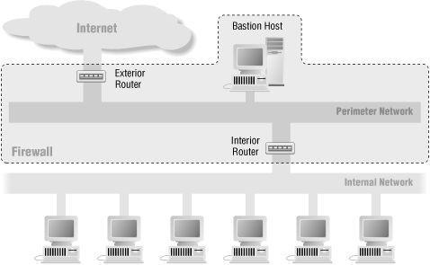
3. Screened Subnet Architecture

Slide 20
Two screening routers, each connected to the perimeter net.
One sits between the perimeter net and the internal network, and the other sits between the perimeter net and the external network.
There is no single vulnerable point that will compromise the internal network.
The perimeter network is another layer of security, an additional network between the external network and your protected internal network.
The interior router does most of the packet filtering for firewall.
Allows selected services outbound from the internal network to the Internet.
The services allow might include outgoing HTTP, Telnet, FTP, and others, as appropriate for needs and concerns.

Slide 21
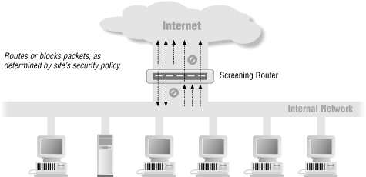
4. Screening Router Architecture

Slide 22
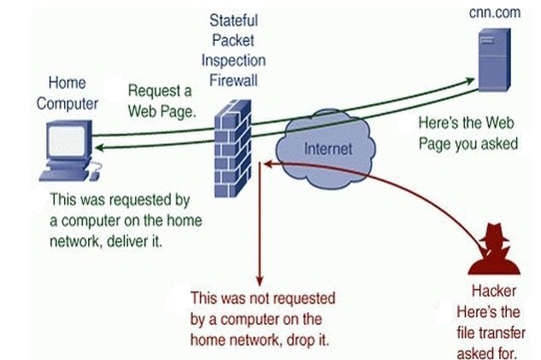
Protection against hacking

Slide 23
Firewall can block the data which the hacker sends to attack the system.
The data passing through the networks are easily blocked as firewall filters the network before passing to the system.
On the outbound side, firewalls can be configured to prevent employees from sending certain types of emails or transmitting sensitive data outside of the network.
Firewalls can prevent outside computers from accessing computers inside the network.
A single computer on the network for file sharing and all other computers could be restricted.

Slide 24
Internet connection firewall is a type of Host-based firewall that helps to protect individual computers in spite of the network it is connected.
Possible to Configure Firewalls Meant to Block Certain Websites
Traffic filtering based on IP address denies information based on network/computers.

Slide 25
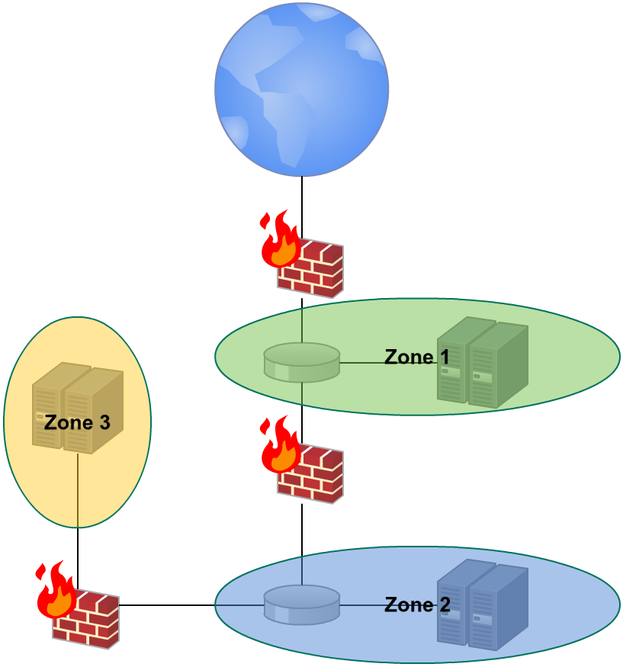
Multi-Layer Firewall protection

Slide 26
Multi-Tier architecture you segregate the network into zones.
Internet to Zone 1
This is the first layer of defense.
Filter out the broad noise from the internet i.e. allow incoming connections only to public services in the DMZ and deny everything else.
Zone 1 to Zone 2
This is the boundary between DMZ (mail server etc.) and internal network
In general, incoming connections initiated in Zone 1 are blocked at this boundary but outgoing connections are allowed

Slide 27
Zone 2 to Zone 3
In Zone 3 have most valued assets.
On this boundary want to be super strict who, when and how can access the assets.
Zone 3 could contain highly sensitive functions like the event centralization and allow only one-way traffic.

Slide 28
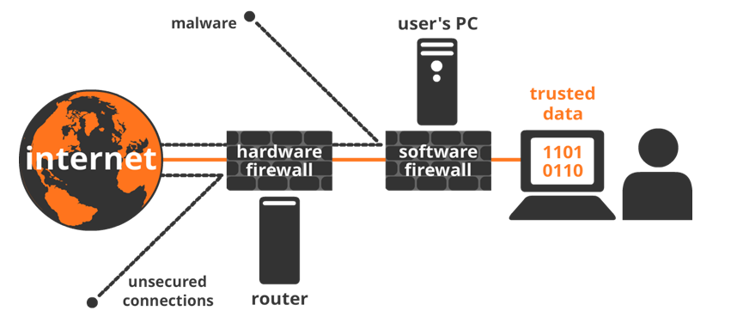
Firewall deployment strategies

Slide 29
Data Center network segments that house systems offering publicly exposed services, such as those contained within a demilitarized zone.
Firewall deployment scenarios, firewalls act as gatekeepers, limiting access to only those services over the Internet that the enterprise feels are necessary.
Rules are determined based on the function of the asset.
Split Architecture design with Internet-accessible servers separated from the corporate assets in a particular isolated network segment.
Assets typically include corporate workstations, critical server components like domain controllers, email servers and enterprise applications.
The application and database servers are hosted on separate segments with access rules restricting access between the Web, application and database tiers.

Slide 30
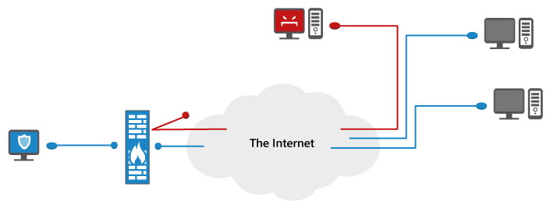
Advantages of using Firewalls

Slide 31
Firewalls use rules to examine network packets as they pass through a particular location on a network.
A Firewall protects computer from unauthorized remote access.
Firewalls can block messages linking to unwanted content.
Firewall logging is the process of monitoring network traffic through a firewall.
Firewall helps block Trojan horses/virus.
Firewall keeps hackers out of your network.
Simplifies audit requirements with instant user identification.
Provides integrated perimeter security.

Slide 32
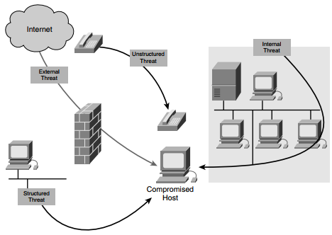
Threats

Slide 33
There are four primary classes of threats:
1. Unstructured threats
2. Structured threats
3. External threats
4. Internal threats
1. Unstructured threats
Unstructured threats consist of mostly inexperienced individuals using easily available hacking tools such as shell scripts and password crackers.
2. Structured threats
Structured threats come from hackers who are more highly motivated and technically competent.
These people know system vulnerabilities and can understand and develop exploit code and scripts.

Slide 34
3. External threats
External threats can arise from individuals or organizations working outside of a company.
They do not have authorized access to the computer systems or network.
4. Internal threats
Internal threats occur when someone has authorized access to the network with either an account on a server or physical access to the network.

Slide 35
Limitations of Firewalls
Firewalls cannot enforce your password policy or prevent misuse of passwords.
Firewalls are ineffective against nontechnical security risks such as social engineering.
Firewalls cannot stop internal users from accessing websites with malicious code, making user education critical.
Firewalls cannot protect from poor decisions.
Firewalls cannot fix poor administrative practices or poorly designed security policies.

Slide 36
THANK YOU !!!

